Slide 1

NYPD CRIME DATA ANALYSIS BIG DATA ANALYTICS
JAYASHREE O 19031
LAKSHAYA K 19039

Slide 2
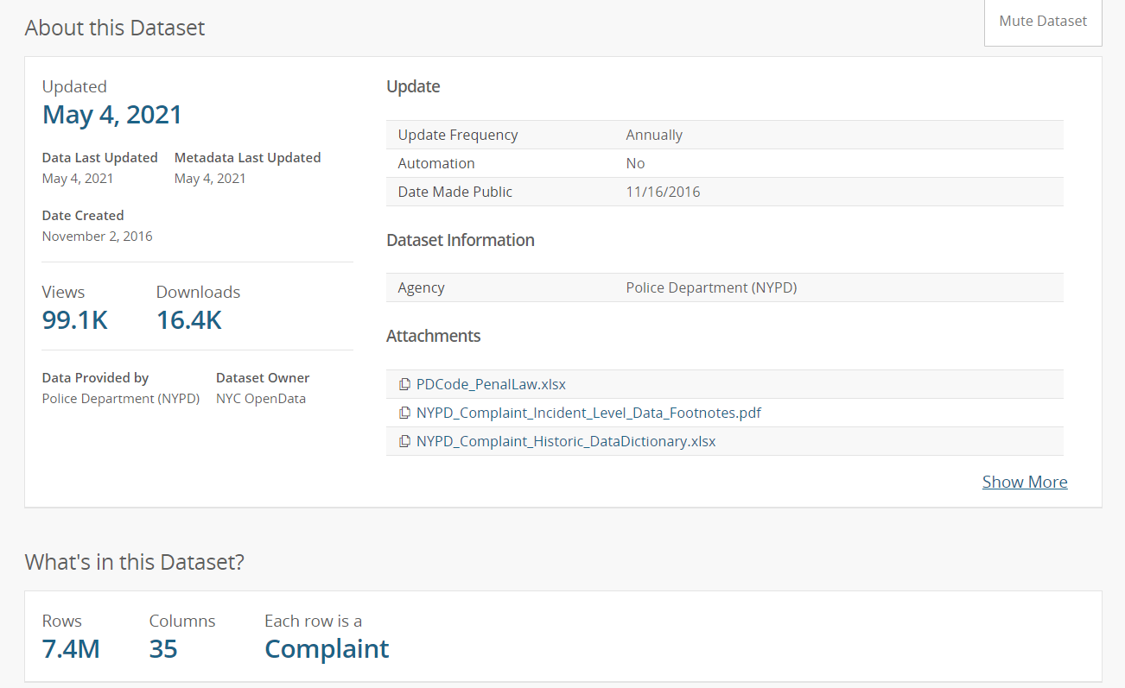
NYPD CRIME DATA SET
This dataset includes all valid felony, misdemeanor, and violation crimes reported to the New York City Police Department (NYPD) from 2006 to the end of last year (2019).
Number of column : 35
Nuuber of Rows : 7.4M
Size of Data : 2.19 GB
Data format : CSV File
https://data.cityofnewyork.us/Public-Safety/NYPD-Complaint-Data-Historic/qgea-i56i

Slide 3
Steps taken:
The following steps were done using the complete dataset & ran on spark-shell in the command window.
Reading & pre-processing the data
Data Analysis
Machine Learning model
[Random Forest Algorithm]
Visualization
In order to visualize the analysis, a sample of the data was taken & the code was run
on Databricks.

Slide 4
01
READING & PRE-PROCESSING

Slide 5
Reading and cleaning the Data
CSV File is read using spark context.
Pre-Processing the data
Making both empty values and unknown values to “null
Splitting the comma separated values
Retrieving the required columns
Mapping to an RDD for analysis.

Slide 6

02
DATA ANALYSIS

Slide 7
Overview of Data Analysis:
Types of Crimes
Crime Status
Correlation between Age of Suspects and crime status
Time of the Day
Month of the Year
Year
Correlation between Location & Crime
Race
Age
Correlation between Borough & Crime

Slide 8
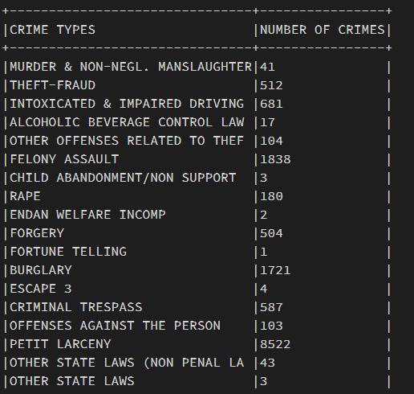
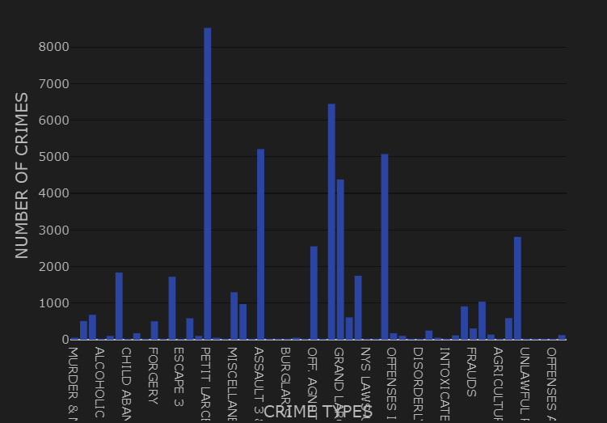
Types of Crimes:
UNIQUE CRIMES

Slide 9
Types of Crimes:
UNIQUE CRIMES
NUMBER OF CRIMES = 56
MOST COMMON CRIME TYPE & CORRESPONDING NUMBER OF CRIMES = (PETIT LARCENY,8522)
LEAST COMMON CRIME TYPE & CORRESPONDING NUMBER OF CRIMES= (FORTUNE TELLING,1)

Slide 10
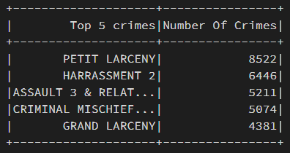
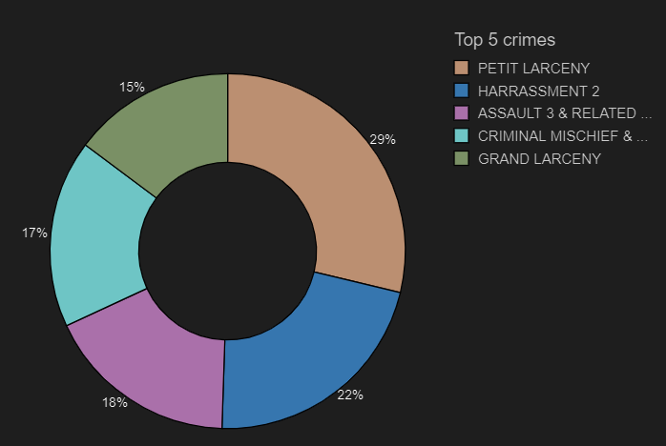
Types of Crimes:
TOP 5 TYPES OF CRIMES

Slide 11
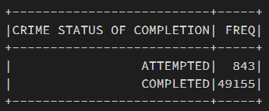
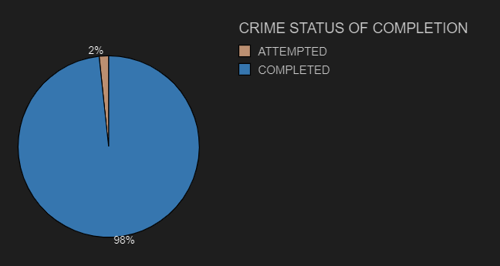
Crime Status:

Slide 12
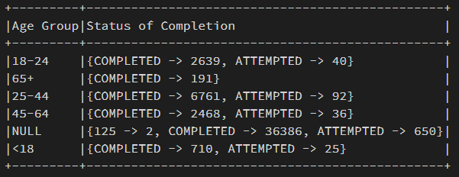
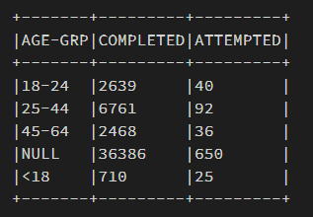
Correlation between
Age of Suspects and Crime Status:

Slide 13
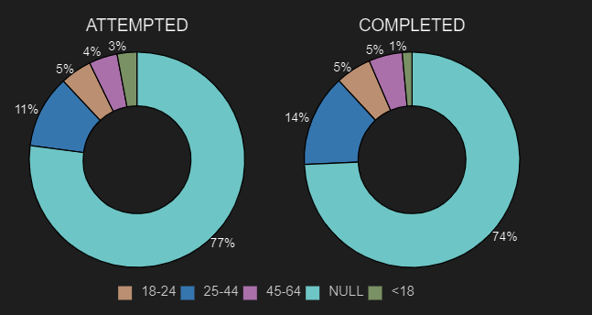
Correlation between
Age of Suspects and Crime Status:

Slide 14
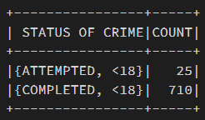
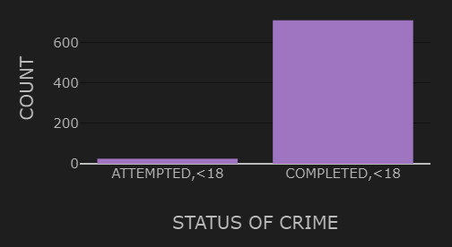
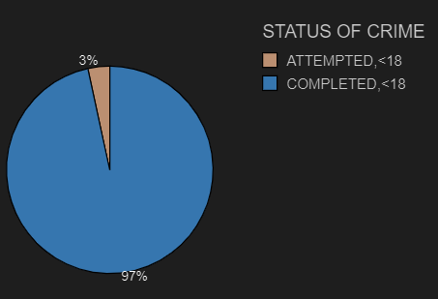
Correlation between Age of Suspects and crime status : Analyzing only the teenage suspects

Slide 15
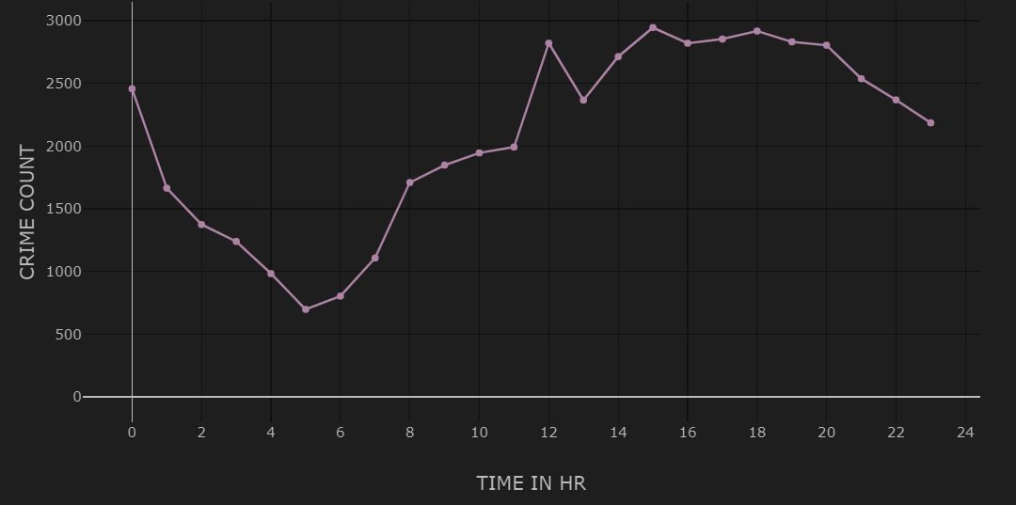
Hourly analysis of crime
Hour at which maximum frequency of crime occurred : (15,2946)
Hour at which minimum frequency of crime occurred : (05,698)

Slide 16
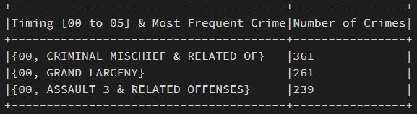
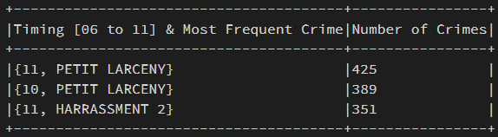
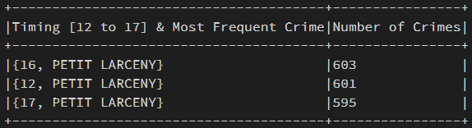
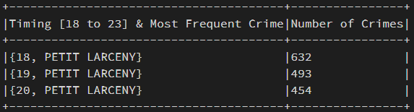
Mapping Hourly analysis & types of crime
Splitting the day into 4 parts

Slide 17
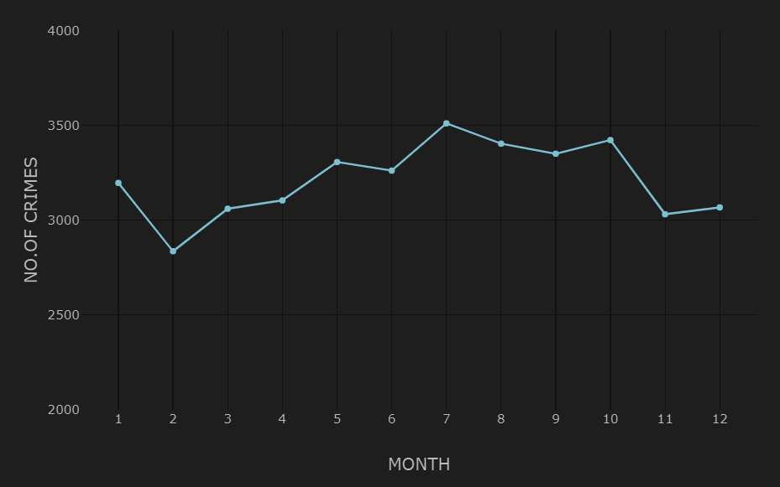
Monthly analysis of crime
Month at which maximum frequency of crime occurred : (7,3510)
Month at which minimum frequency of crime occurred : (2,2836)

Slide 18
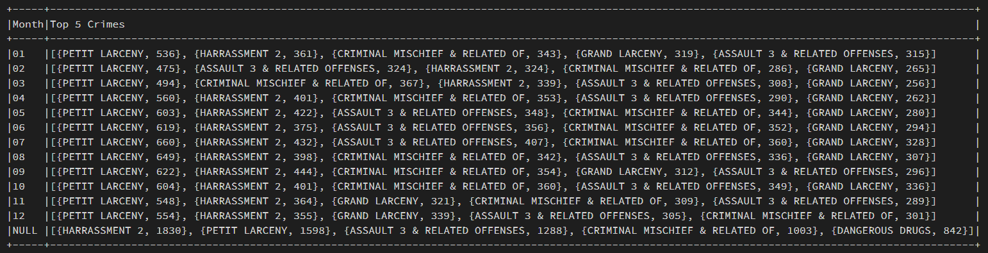
Mapping Monthly analysis & types of crime
Splitting the day into 4 parts

Slide 19
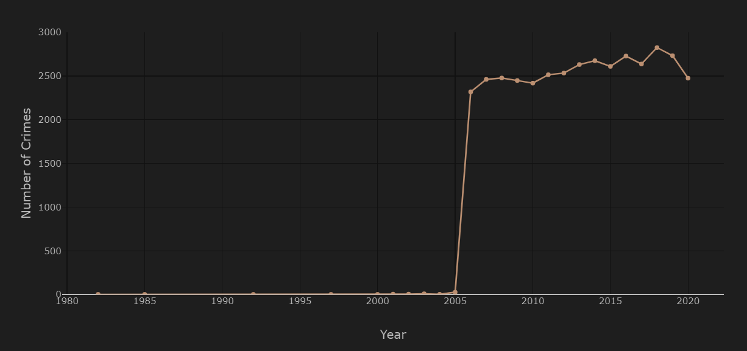
Yearly analysis of crime
Year at which maximum frequency of crime occurred : (2018, 2826)

Slide 20
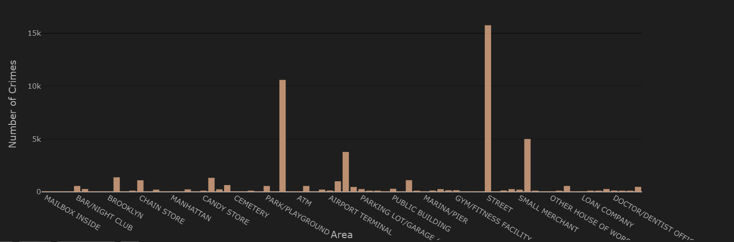
Location analysis of crime
Most common location & frequency: (Street, 15757)
Least common location & frequency: (Mailbox Inside, 4)

Slide 21
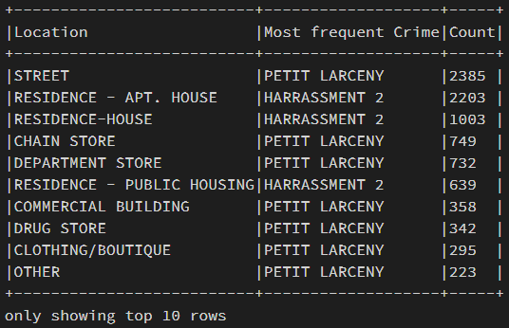
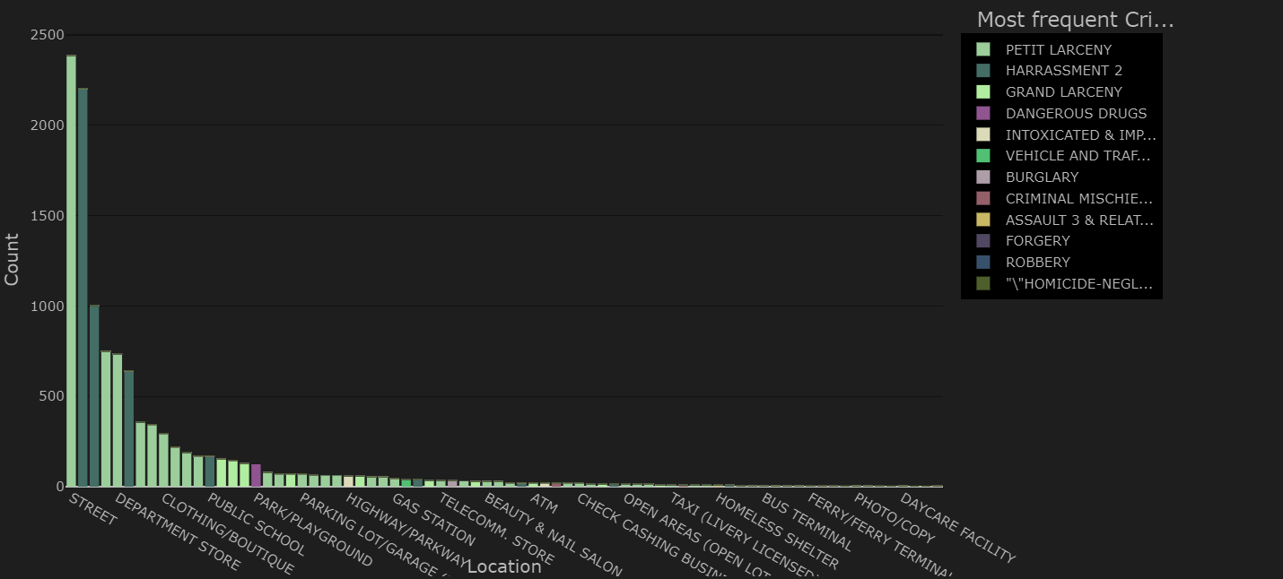
Correlation between Location & Crime

Slide 22
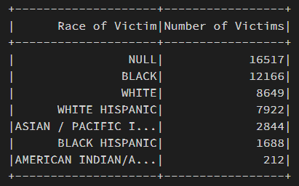
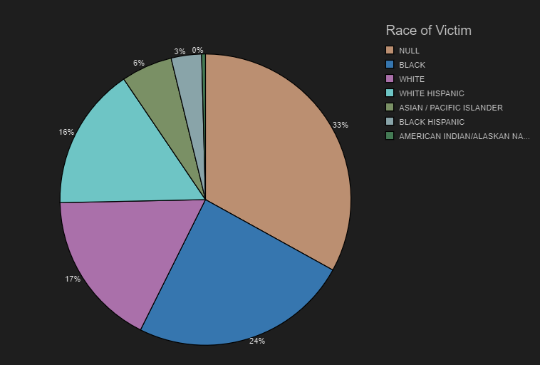
Analysis of Victim’s Race:
Most common race (excluding NULL) & frequency: BLACK, 12166
Least common race & frequency:
AMERICAN INDIAN/ALASKAN NATIVE, 212

Slide 23
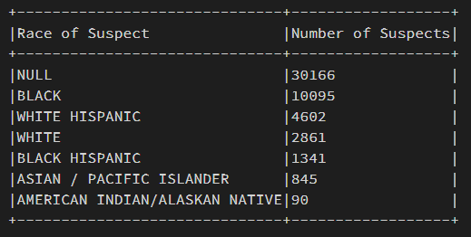
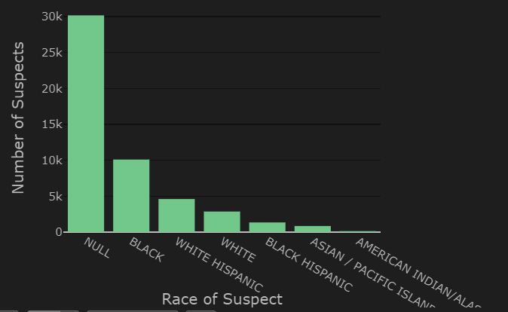
Analysis of Suspect’s Race:
Most common(excluding NULL) & frequency: BLACK, 10095
Least common & frequency: AMERICAN INDIAN/ALASKAN NATIVE, 90

Slide 24
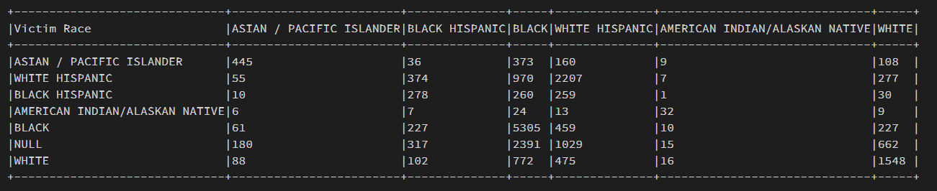
Mapping Suspect’s Race to Victim’s Race:

Slide 25
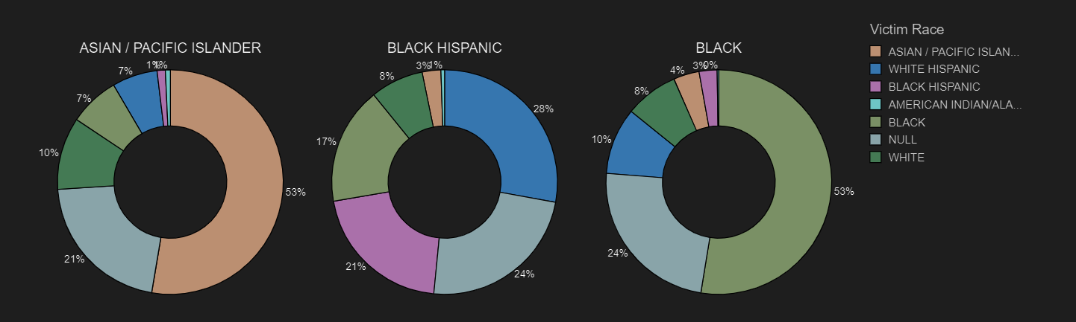
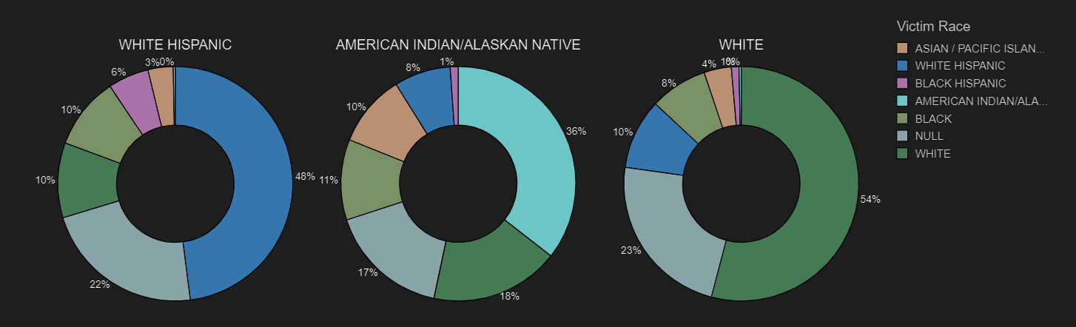
Mapping Suspect’s Race to Victim’s Race:

Slide 26
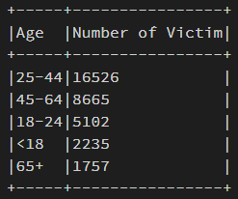
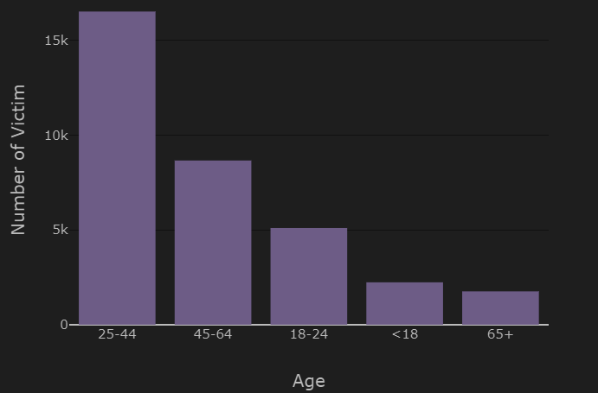
Analysis of Age Groups of Victims:
Most common & frequency: 25-44, 16526
Least common & frequency: 65+, 1757

Slide 27
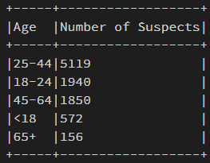
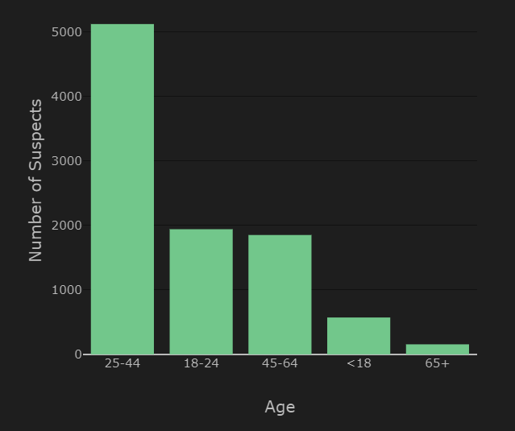
Analysis of Age Groups of Suspects:
Most common & frequency: 24-44, 5119
Least common & frequency: 65+, 156

Slide 28
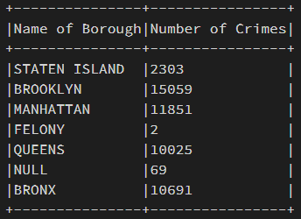
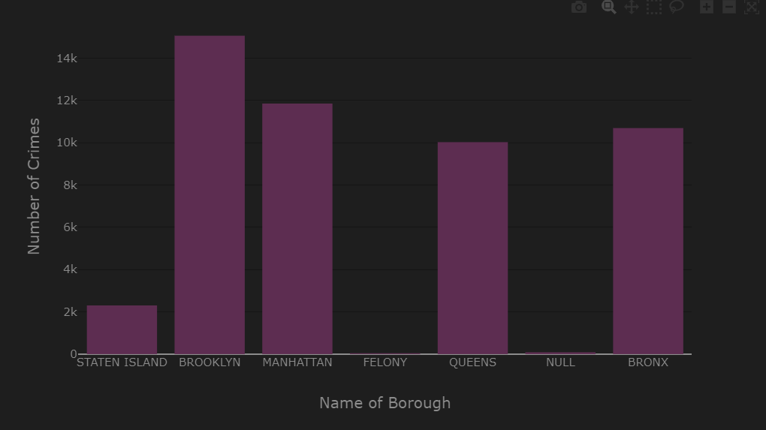
Borough Analysis of Crimes:
Most common & frequency: BROOKLYN, 15095
Least common & frequency (Excluding NULL & FELONY):
STATEN ISLAND, 2302

Slide 29
03
MACHINE LEARNING

Slide 30
Target:
Suspect’s Age
Features:
Location
Borough
Crime Code
Victim’s Age
Level of Offense

Slide 31
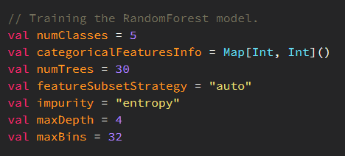
Random Forest
StringIndexer was used to map all the string columns to indices
Required columns were stored as a LibSVM file
<label> <index1>:<value1> <index2>:<value2>
LibSVM file was read & parsed
Train-Test Split → 70-30
Model can be trained to perform better as a further continuation of this project

Slide 32

A Picture Is Worth a Thousand Words

Slide 33
Awesome Words

Slide 34
Clear Direction and Goals
Mercury
Jupiter
Venus
Saturn
Mercury is the
closest planet to the Sun
It’s the biggest
planet in the Solar System
Venus has a poisonous atmosphere
Saturn is the
ringed one and a gas giant

Slide 35
In Depth
Mercury
Mercury is the closest planet to the Sun and the smallest one in the Solar System—it’s only a bit larger than the Moon. The planet’s name has nothing to do with the liquid metal

Slide 36
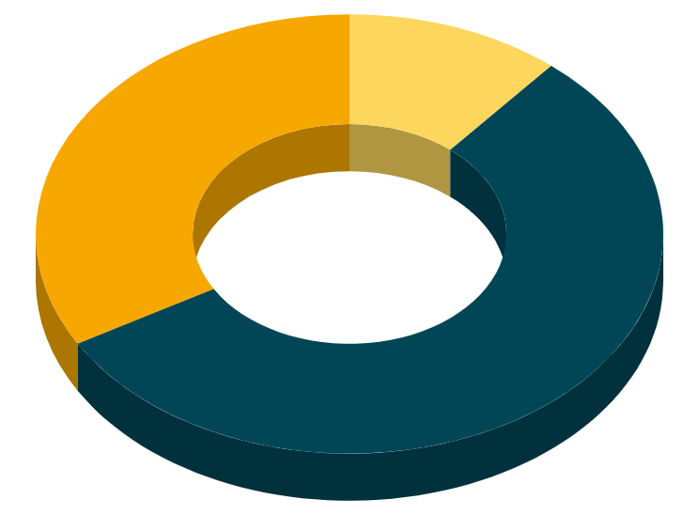
This Is a Graph!
33%
11%
Venus
Mars
Saturn
56%
Venus has a beautiful name, but it’s very hot
Despite being red, Mars is a cold place
Saturn is the ringed one and a gas giant
To modify this graph, click on it, follow the link, change the data and paste the new graph here

Slide 37
This Is an Infographic
45
55
65
75
Mercury
Jupiter
Venus
Saturn
Mercury is the
closest planet to the Sun
It’s the biggest
planet in the Solar System
Venus has a poisonous atmosphere
Saturn is the
ringed one and a gas giant

Slide 38
Another Infographic
100%
Venus
70%
Mars
30%
Saturn
Venus has a beautiful name, but it’s terribly hot
Despite being red, Mars is actually a cold place
Saturn is the ringed one and a gas giant

Slide 39
Maybe You Need to Divide
the Content
Mercury
Venus
Mercury is the closest planet to the Sun and the smallest one
Venus has a beautiful name and is the second planet from the Sun

Slide 40
Skills
Mercury
Jupiter
Mercury is the
closest planet to the Sun
It’s the biggest
planet in the Solar System
Venus
Saturn
Venus has a poisonous atmosphere
Saturn is the
ringed one and a gas giant
Mars
Neptune
Despite being red, Mars is a cold place
Neptune is the
farthest planet
from the Sun

Slide 41
Problem-Solving Skills
?
Mars
Jupiter
Saturn
?
Despite being red, Mars is actually a cold place
Jupiter is a gas giant and the biggest planet
It’s composed mostly of hydrogen and helium

Slide 42
A Timeline Always
Works Well
Day 1
Day 2
Day 3
Day 4
Mercury is the
closest planet to the Sun
It’s the biggest
planet in the Solar System
Despite being red, Mars is a cold place
Venus has a poisonous atmosphere

Slide 43
4,498,300
Big numbers catch your audience’s attention

Slide 44
333,000.00
24h 37m 23s
386,000 km
earths is the Sun’s mass
is Jupiter’s rotation period
is the distance between Earth and the Moon

Slide 45
This Is a Map
Venus
Venus has a
beautiful name
Mercury
It’s the closest planet to the Sun
Mars
Despite being red, Mars is a cold place

Slide 46
These Are Percentages
45%
80%
60%
Mercury
Mars
Saturn
Mercury is the closest planet to the Sun
Despite being red, Mars is a cold place
Saturn is the ringed one and a gas giant

Slide 47

This Text Seems to Be Important
Mercury is the closest planet to the Sun and the smallest one in the Solar System—it’s only a bit larger than the Moon

Slide 48
Monthly Calendar
Mon | Tue | Wed | Thu | Fri | Sat | Sun
01 | 02 | 03 | 04 | 05 | 06 | 07
08 | 09 | 10 | 11 | 12 | 13 | 14
15 | 16 | 17 | 18 |  | 20 | 21
22 | 23 | 24 | 25 | 26 | 27 | 28
29 | 30 | 31

Slide 49
Weekly Calendar
Hours | Mon | Tue | Wed | Thu | Fri | Sat | Sun
8:00 / 9:00 | Mars | Saturn | - | - | Venus | - | -
9:00 / 10:00 | Venus | - | Venus | Mars | - | - | -
10:00 / 11:00 | - | Mars | - | - | Saturn | - | -
11:00 / 12:00 | Saturn | - | - | Venus | - | - | -
12:00 / 13:00 | - | Venus | Mars | Saturn | - | - | Moon
13:00 / 14:00 | Venus | - | Saturn | - | Mars | Earth | -

Slide 50
Take Notes!
Important
To Do
Remember
Write here your important notes
Write here your important notes
Write here your important notes

Slide 51
Future Projects
Write your future project’s description here
Write your future project’s description here
Write your future project’s description here
Write your future project’s description here
Write your future project’s description here

Slide 52

Desktop Software
You can replace the image on the screen with your own work. Just delete this one, add yours and center it properly

Slide 53

Thanks!
Do you have any questions?
addyouremail@freepik.com
+91 620 421 838
yourcompany.com
Please keep this slide for attribution

